Slide 1
Rx Project Review
4/2/13

Slide 2
Agenda
Rx.NET
Rx project history
Rx technical overview
Internal & external customers
Upcoming plans
RxCpp
Rx/MI Partnership

Slide 3
Rx.NET

Slide 4
A brief history of Rx
Rx 1.0 – Nov 2009
.NET 3.5/4, Windows Phone 7
IObservable/IObserver shipped in the BCL as of .NET 4.0
Rx 2.0 – Aug 2012
Refactored into multiple assemblies to support portable libraries
Added platform-specific thread schedulers
Temporal query operators
Interop with async/await
.NET 4/4.5, Windows Phone 7.5/8, Windows 8
Notes:
public static IObservable<TSource> Skip<TSource>(this IObservable<TSource> source,
TimeSpan duration);
public static IObservable<TSource> Skip<TSource>(this IObservable<TSource> source,
TimeSpan duration,
IScheduler scheduler);
public static IObservable<TSource> SkipLast<TSource>(this IObservable<TSource> source,
TimeSpan duration);
public static IObservable<TSource> SkipLast<TSource>(this IObservable<TSource> source,
TimeSpan duration,
IScheduler scheduler);
public static IObservable<TSource> SkipUntil<TSource>(this IObservable<TSource> source,
DateTimeOffset startTime);
public static IObservable<TSource> SkipUntil<TSource>(this IObservable<TSource> source,
DateTimeOffset startTime,
IScheduler scheduler);
public static IObservable<TSource> Take<TSource>(this IObservable<TSource> source,
TimeSpan duration);
public static IObservable<TSource> Take<TSource>(this IObservable<TSource> source,
TimeSpan duration,
IScheduler scheduler);
public static IObservable<TSource> TakeLast<TSource>(this IObservable<TSource> source,
TimeSpan duration);
public static IObservable<TSource> TakeLast<TSource>(this IObservable<TSource> source,
TimeSpan duration,
IScheduler scheduler);
public static IObservable<TSource> TakeUntil<TSource>(this IObservable<TSource> source,
DateTimeOffset startTime);
public static IObservable<TSource> TakeUntil<TSource>(this IObservable<TSource> source,
DateTimeOffset startTime,
IScheduler scheduler);

Slide 5
A brief history of Rx
Open source release (Rx 2.1) – Nov 2012
Source released through MS Open Tech (rx.codeplex.com)
Binaries released by Microsoft via NuGet
Notes:
public static IObservable<TSource> Skip<TSource>(this IObservable<TSource> source,
TimeSpan duration);
public static IObservable<TSource> Skip<TSource>(this IObservable<TSource> source,
TimeSpan duration,
IScheduler scheduler);
public static IObservable<TSource> SkipLast<TSource>(this IObservable<TSource> source,
TimeSpan duration);
public static IObservable<TSource> SkipLast<TSource>(this IObservable<TSource> source,
TimeSpan duration,
IScheduler scheduler);
public static IObservable<TSource> SkipUntil<TSource>(this IObservable<TSource> source,
DateTimeOffset startTime);
public static IObservable<TSource> SkipUntil<TSource>(this IObservable<TSource> source,
DateTimeOffset startTime,
IScheduler scheduler);
public static IObservable<TSource> Take<TSource>(this IObservable<TSource> source,
TimeSpan duration);
public static IObservable<TSource> Take<TSource>(this IObservable<TSource> source,
TimeSpan duration,
IScheduler scheduler);
public static IObservable<TSource> TakeLast<TSource>(this IObservable<TSource> source,
TimeSpan duration);
public static IObservable<TSource> TakeLast<TSource>(this IObservable<TSource> source,
TimeSpan duration,
IScheduler scheduler);
public static IObservable<TSource> TakeUntil<TSource>(this IObservable<TSource> source,
DateTimeOffset startTime);
public static IObservable<TSource> TakeUntil<TSource>(this IObservable<TSource> source,
DateTimeOffset startTime,
IScheduler scheduler);

Slide 6
Interactive Extensions (Ix)
Related project
Enhances LINQ to Objects with similar operators as Rx
Open sourced through MS Open Tech (rx.codeplex.com)
Released via NuGet

Slide 7




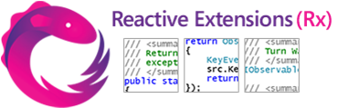



The Event Processing Landscape
GPS
RSS feeds
Stock tickers
Social
media
UI events
Server management

Slide 8
Reactive Extensions Architecture
from quote in stock
where quote.Symbol == “MSFT”
select quote.Value
Windowing
Grouping
Sampling
Filtering
Recovery
Sharing
Projection
Merging
LINQ to Events
Throttling
Aggregating
Timeout
Joins
IObservable<T>
ISubject<T>
IObserver<T>
Event Streams
IScheduler
Threads
Cloud
Dispatchers
Time
Concurrency

Slide 9
Reactive Extensions Architecture
from quote in stock
where quote.Symbol == “MSFT”
select quote.Value
Windowing
Grouping
Sampling
Filtering
Recovery
Sharing
Projection
Merging
LINQ to Events
Throttling
Aggregating
Timeout
Joins
IObservable<T>
ISubject<T>
IObserver<T>
Event Streams
IScheduler
Threads
Cloud
Dispatchers
Time
Concurrency

Slide 10
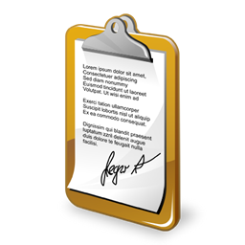

Event Streams
Towards a unified programming model
Producers are observable sequences
.NET events, WinRT events, sensor APIs, APM methods, tasks, etc.
Consumers are observers
Hooking up “continuations” or handlers
Observable
Subscribe
Observer

Slide 11
Essential Interfaces
namespace System
{
public interface IObservable<out T>
{
IDisposable Subscribe(IObserver<T> observer);
}
public interface IObserver<in T>
{
void OnNext(T value);
void OnError(Exception error);
void OnCompleted();
}
}

Slide 12

Stock Trade Analysis
MSFT
27.01
INTC
21.75
MSFT
27.96
MSFT
31.21
INTC
22.54
INTC
20.98
MSFT
30.73
ticks
from tick in ticks

Slide 13
Stock Trade Analysis
MSFT
27.01
INTC
21.75
MSFT
27.96
MSFT
31.21
INTC
22.54
INTC
20.98
MSFT
30.73
ticks
27.01
27.96
31.21
30.73
MSFT
21.75
22.54
20.98
INTC
from tick in ticks
group tick by tick.Symbol

Slide 14
Stock Trade Analysis
MSFT
27.01
INTC
21.75
MSFT
27.96
MSFT
31.21
INTC
22.54
INTC
20.98
MSFT
30.73
ticks
[27.01, 27.96]
[27.96, 31.21]
[31.21, 30.73]
MSFT
[21.75, 22.54]
[22.54, 20.98]
INTC
from tick in ticks
group tick by tick.Symbol into company
from openClose in company.Buffer(2, 1)

Slide 15
Stock Trade Analysis
MSFT
27.01
INTC
21.75
MSFT
27.96
MSFT
31.21
INTC
22.54
INTC
20.98
MSFT
30.73
ticks
0.034
0.104
-0.015
MSFT
0.036
-0.069
INTC
from tick in ticks
group tick by tick.Symbol into company
from openClose in company.Buffer(2, 1)
let diff = (openClose[1] – openClose[0]) / openClose[0]

Slide 16
Stock Trade Analysis
MSFT
27.01
INTC
21.75
MSFT
27.96
MSFT
31.21
INTC
22.54
INTC
20.98
MSFT
30.73
ticks
0.034
0.104
-0.015
MSFT
0.036
-0.069
INTC
from tick in ticks
group tick by tick.Symbol into company
from openClose in company.Buffer(2, 1)
let diff = (openClose[1] – openClose[0]) / openClose[0]
where diff > 0.1

Slide 17
Stock Trade Analysis
MSFT
27.01
INTC
21.75
MSFT
27.96
MSFT
31.21
INTC
22.54
INTC
20.98
MSFT
30.73
ticks
res
Company = MSFT
Increase = 0.104
from tick in ticks
group tick by tick.Symbol into company
from openClose in company.Buffer(2, 1)
let diff = (openClose[1] – openClose[0]) / openClose[0]
where diff > 0.1
select new { Company = company.Key, Increase = diff }

Slide 18

The Query Processing Landscape
IQueryable<T>
IQbservable<T>
Query language
translation
Expression trees
LINQ to SQL (T-SQL)
Expression trees
LINQ to WMI (WQL)
LINQ
IEnumerable<T>
IObservable<T>
Local execution (in-process IL)
Iterators (yield)
LINQ to Objects
Observable.Create
LINQ to Events (Rx)
Pull-based
Push-based

Slide 19
The Asynchronous Programming Landscape
IEnumerable<T>
IObservable<T>
var res = from p in products
where p.Name == “Rx”
select p.Price;
foreach (var x in res)
…
var res = from s in stocks
where s.Symbol == “MSFT”
select q.Quote
res.Subscribe(x =>
…
Multiple values (*)
Func<T>
Task<T>
Single value (1)
var y = f(x);
var z = g(y);
var y = await fAsync(x);
var z = await gAsync(y);
Synchronous
Asynchronous

Slide 20
Main Internal Customers
System Center
Windows Server
Bing
Skype
SQL CAT
Commerce
GFS

Slide 21
Some External Customers
Citigroup
Ferranti
Equifax IXI
Achmea
GitHub for Windows
Lab49
Viddy
Logica

Slide 22
Upcoming plans for Rx.NET
Move all samples/documentation from MSDN to CodePlex
More community engagement
CodePlex pull requests, StackOverflow, blog posts
Presentations at industry conferences
In-depth articles, e.g. for CACM, ACM Queue, etc.
More customer engagement
How do customers use Rx?
What features would unblock customers and/or make Rx easier to use?
Partnership with SQL CAT
Develop strategic internal partnerships
Hadoop, Azure Mobile Services, DevDiv (.NET Framework, C#)

Slide 23
RxCpp Rx/MI

Slide 24
RxCpp

Slide 25
C++ LINQ
C++ LINQ
Two versions for two kinds of developers:
Static dispatch - best performance (~4x faster C#)
Dynamic dispatch - for interfaces / small codegen
Mutually compatible with C++ iterators
Reactive Extensions (Rx) for C++
Using C++ 11
Portable

Slide 26
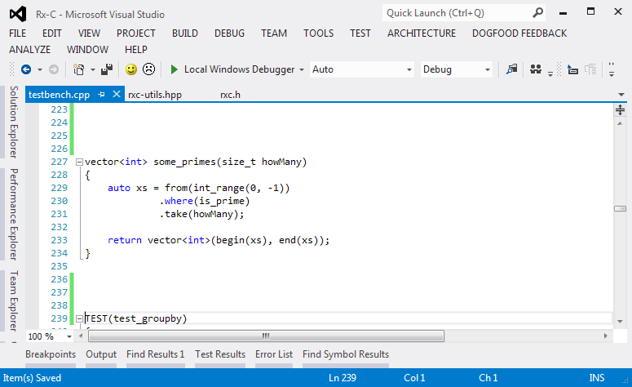
Demo

Slide 27
Rx/MI Partnership

Slide 28
Upcoming deliverables

Slide 29
Rx Operators - Implemented
Where
Select
GroupBy
TakeN
And more:
W
S
Gb
T_{N}
Subscribe
CreateObservable
ArrayToObservable
Merge
MergeArray
Return
CreateSubject
Publish
Count
Window

